Slide 1

Generating Solutions

Slide 2

Some Key Outcomes
To identify and remove “blocks” to creativity in solving problems
To become aware of ways to foster creativity among others

Slide 3

Creativity
Generation of new ideas
The process of associating known things or ideas into new combinations and relationships
Creative vs. Critical Thinking

Slide 4
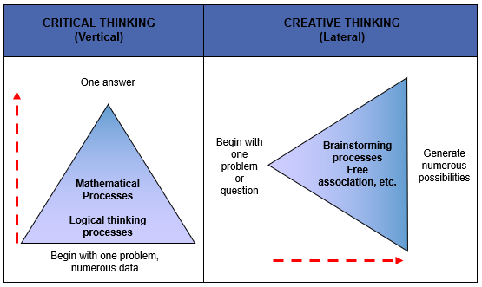

Slide 5
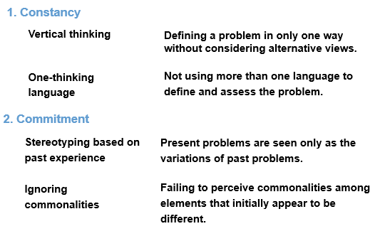
Conceptual Blocks that Inhibit Creative Problem Solving

Slide 6
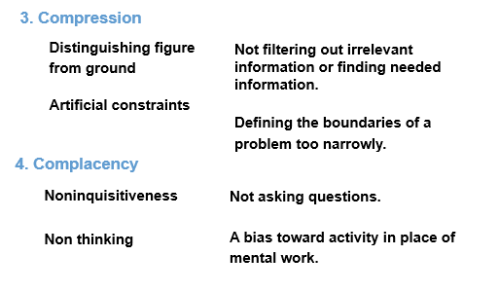
Conceptual Blocks that Inhibit Creative Problem Solving

Slide 7
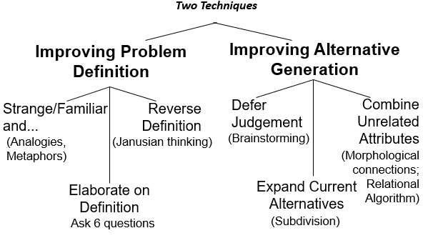
Block Busting

Slide 8
Improving Alternative Generation
Defer Judgment (Brainstorm)
  No evaluation of any kind as alternatives are generated
  Wildest possible ideas are encouraged
  Quantity of ideas takes precedence over quality
  Participants should build on or modify ideas of others
Expand Current Alternatives
  Divide the problem into smaller parts
  For example:
    (1) How many uses can you generate for a ping pong ball?
    (2) Now identify specific characteristics of ping pong ball (weight, color, texture, etc.) – how many more alternative uses can you think of?

Slide 9
BRAINSTORMING AND
NOMINAL GROUP TECHNIQUE (NGT)
  Agree on the problem definition
  Write down all ideas
  Use round robin to allow participation
  After sharing and rewriting ideas, review each idea one at a time
  Vote (secret, rank vote)
  Review the voting pattern

Slide 10
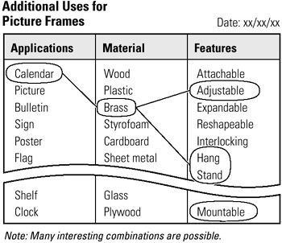
Improving Alternative Generation
Morphological Connections
This is all about connecting the various sub-components of the problem in different ways
List the attributes of the situation
Below each attribute, place as many alternates as you can think of
When completed, make many random runs through the alternates, picking up a different one from each column and assembling the combinations into entirely new forms of your original subject.
Example ->
Image source: https://flylib.com/books/en/2.890.1.198/1/

Slide 11
Improving Alternative Generation
“How might I improve the marketing of my latest book?”
improve/behind/book
improve/beyond/book
improve/when/book
improve/during/book
Some possibilities:
Behind: make prominent mention of my previous (best-selling) book in the campaign, so search engines will pick up both references
When: Include a coupon for a discount of my previous book
During: Offer free information from the book on my website and in my newsletter
Beyond: schedule my Facebook and Twitter updates to reach more time zones
Beyond: include interactive games based on my book on my website
Relational Algorithms
Relational Algorithms combines elements from the problem statement with randomly chosen words from a set.
Start with your problem definition.
Identify the action verb and object.
Finally, insert a relational word between the two words you have underlined.
Example ->
Example Source: https://www.psychsoma.co.za/syntarotis/2012/01/relational-algorithms-a-problem-solving-technique.html/

Slide 12
Creativity: Some Conclusions
Creativity is a process, not a trait or an outcome
Creativity is frequently a team variable – requires attention to different roles, styles, and power relationships
Creativity can be learned/refined/encouraged

Slide 13
Four Major Creativity Mistakes
Defining problems incorrectly
Judging ideas too quickly
Stopping with first good idea
Failing to get a sponsor

Slide 14
Hints for Skill Application
Give yourself some relaxation time
Find a place where you can think
Talk to others about ideas
Ask others about your problem
Read (unrelated) a lot!
Protect yourself from idea killers!

Slide 15
“You will win some. You will lose some. Only mediocre people are always at their best!”
Somerset Maugham (Quoted in Miller, The Creative Edge: Fostering Innovation Where you Work, Reading, MA: Addison Wesley, 1987, p.17)

