Slide 1
Defining Problems

Slide 2
Some Key Outcomes
To identify and remove “blocks” to creativity in solving problems
To become aware of ways to foster creativity among others

Slide 3
Creativity
Generation of new ideas
The process of associating known things or ideas into new combinations and relationships
Creative vs. Critical Thinking

Slide 4
Barriers to Creative Thinking
Cultural
Negative value on reflection and fantasy
Children should play, adults should be serious
Problem solving is serious, thus humor is out of place…
Feeling and intuition are illogical and impractical

Slide 5
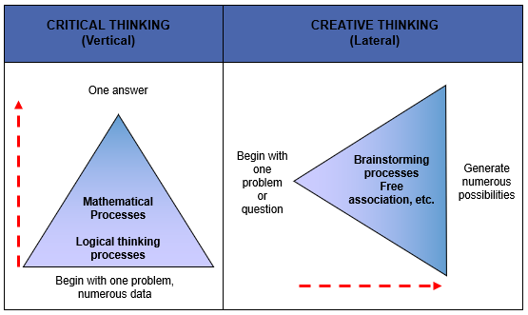

Slide 6
The Rational Model of Problem Solving
STEPS | CHARACTERISTICS
1. Define the problem.
Differentiate fact from opinion.
Specify underlying causes.
Tap everyone involved for information.
State the problem explicitly.
Identify what standard is violated.
Determine whose problem it is.
Avoid stating the problem as a disguised solution.

Slide 7
The Rational Model of Problem Solving
STEPS | CHARACTERISTICS
2. Generate alternative solutions.
Postpone evaluating alternatives.
Be sure all involved individuals generate alternatives.
Specify alternatives that are consistent with goals.
Specify both short-term and long-term alternatives.
Build on others’ ideas.
Specify alternatives that solve the problem.

Slide 8
The Rational Model of Problem Solving
STEPS | CHARACTERISTICS
3. Evaluate and select an alternative.
Evaluate relative to an optimal standard.
Evaluate systematically.
Evaluate relative to goals.
Evaluate main effects and side effects.
State the selected alternative explicitly.

Slide 9
The Rational Model of Problem Solving
STEPS | CHARACTERISTICS
4. Implement and follow up on the solution.
Implement at the proper time and in the right sequence.
Provide opportunities for feedback.
Engender acceptance of those who are affected.
Establish an ongoing monitoring system.
Evaluate based on problem solution.

Slide 10
Rational Problem-Solving Model Constraints
STEPS | CHARACTERISTICS
1. Define the problem.
There is seldom consensus as to the definition of the problem.
There is often uncertainty as to whose definition will be accepted.
Problems are usually defined in terms of the solutions already possessed.

Slide 11
Rational Problem-Solving Model Constraints
STEPS | CHARACTERISTICS
2. Generate alternative solutions.
Solution alternatives are usually evaluated one at a time as they are proposed.
Few of the possible alternatives are usually known.
The first acceptable solution is usually accepted.
Alternatives are based on what was successful in the past.

Slide 12
Rational Problem-Solving Model Constraints
STEPS | CHARACTERISTICS
Limited information about each alternative is usually available.
Search for information occurs close to home – in easily accessible places.
The type of information available is constrained by factors such as primacy versus recency, extremity versus centrality, expected versus surprising, and correlation versus causation.
3. Evaluate and select an alternative.

Slide 13
Rational Problem-Solving Model Constraints
STEPS | CHARACTERISTICS
3. Evaluate and select an alternative (continued).
Gathering information on each alternative is costly.
Preferences of which is the best alternative are not always known.
Satisfactory solutions, not optimal ones, are usually accepted.
Solutions are often selected by oversight or default.
Solutions often are implemented before the problem is defined.

Slide 14
Rational Problem-Solving Model Constraints
STEPS | CHARACTERISTICS
4. Implement and follow up on the solution.
Acceptance of the solution by others is not always forthcoming.
Resistance to change is a universal phenomenon.
It is not always clear what part of the solution should be monitored or measured in follow-up.
Political and organizational processes must be managed in any implementation effort.
It may take a long time to implement a solution.

Slide 15
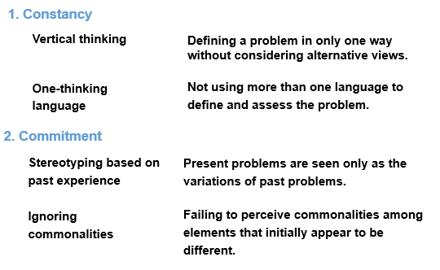
Conceptual Blocks that Inhibit Creative Problem Solving

Slide 16
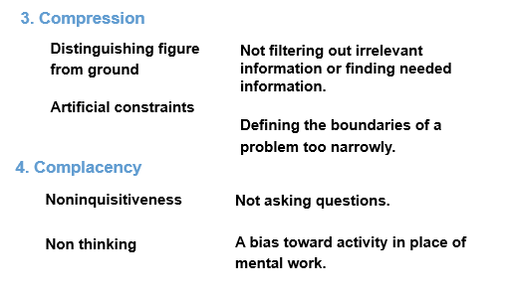
Conceptual Blocks that Inhibit Creative Problem Solving

Slide 17
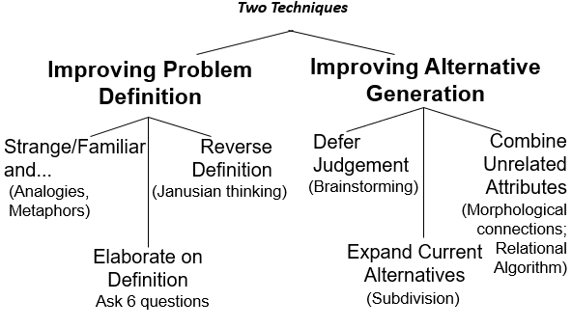
Block Busting through Creativity

Slide 18
Improving Problem Definition
Make the strange familiar, and the familiar strange, by using analogies:
What does this remind me of?
What does this make me feel like?
What is this similar to?
What isn’t this similar to?
Hints:
Include action or motion in the analogy
Include things that can be visualized
Pick familiar events and situations
Try to relate things that are not obviously similar

Slide 19
Improving Problem Definition
Elaborate on the definition
Is there anything else?
Is the reverse true?
Is there a more general problem?
Can it be stated differently?
Who sees it differently?
What past experience was this like?
Reverse the definition
Turn the problem upside down, inside out, or back to front.

Slide 20
Apply at least two (2) improving problem definition techniques to Assignment 1: Defining Problems

